Slide 1
AI Voice Agent Application

Slide 2
Learning Outcomes
Upon completion of this session, the learners should be able to:
Understand the overview of AI Voice Agent Stack Components.
Apply the Stack Components to develop the AI Voice Agent application.
Explain how speech becomes text and text becomes speech inside the stack.
Describe the client–server architecture and the agent’s perceive–reason–act loop.
Evaluate a voice agent using WER, RTF, MOS and latency, and apply data-privacy practices.

Slide 3


What is an AI Voice Agent?
Definition: Voice Agents combine speech and reasoning abilities of foundation models to deliver real-time, human-like voice interactions.
Use Cases
  Improve learning: Guide personalized skill development, conduct interviews.
  Handle customer service voice calls (Restaurant booking, sales, insurance).
  Improve accessibility in medical and talk therapy application.
Output:
System Voice
Response
Or
System Video
Response
Input: User Voice
Query
Speech to
Text
LLM or Agentic LLM
workflow
Text to Speech
Speech to
Speech (aka Real time)

Slide 4
Voice Agent Stack Components
Automatic Speech Recognition (ASR), also known as Speech-to-Text (STT): the task of transcribing a given audio signal to text.
Audio → Text.
LLMs and LLM agent: Generate a response to the transcribed query.
Text → Text or multimodal response (e.g. text or images).
Text-to-Speech (TTS), also known as Speech Synthesis: the task of generating natural and intelligible speech from text.
Text → Audio.
Notes:
1. Transcriber (Listen)
The transcriber component converts raw audio input (human speech) into text. When a user speaks, their voice is captured as raw audio data and processed to produce accurate text transcription. This text then serves as the input for the language model.
2. Model (Process)
The language model (LLM) represents the "brain" of the system. It receives the transcribed text, processes it according to its training and the provided prompt, and generates an appropriate response. The model's capabilities determine how well it understands context, maintains conversation history, and produces relevant outputs.
3. Voice (Speak)
The voice component transforms the text generated by the model back into speech. This text-to-speech conversion creates the audible response that the user hears. The quality, naturalness, and characteristics of this synthetic voice significantly impact the user experience.
What makes Vapi voice AI powerful is its ability to seamlessly integrate these three components while allowing developers to swap out providers for each component. You can use different services for transcription (like Deepgram or Talk Scribe), language models (OpenAI, Anthropic, etc.), and voice synthesis (ElevenLabs, Rhyme AI, Azure, etc.).
Vapi handles the complex orchestration between these components, optimizes latency, manages scaling, and ensures smooth conversation flow. For performance optimization, understanding this architecture is crucial-it helps identify which component might be causing issues and where adjustments can yield the greatest improvements.

Slide 5
Technical Foundations: From Sound to Meaning
Every voice agent runs the same five stages — the next slides open each box
1 Capture
Microphone picks up an analog signal and digitises it
2 Features
FFT / MFCC turn the signal into a spectrogram
3 Recognise
ASR maps features to phonemes, then to text
4 Reason
The LLM agent perceives, reasons and decides an action
5 Speak
TTS turns the reply back into a natural waveform
Latency is the sum of all five. Each stage adds delay, so every optimisation later in this lecture — streaming STT, fast first tokens, streaming TTS — is an attack on one of these boxes.
Two ways to build it
Cascaded pipeline: separate STT → LLM → TTS services — flexible, easier to debug, more latency.
Speech-to-speech: one real-time multimodal model — lower latency, less control over each step.
Content adapted from: Deepgram — “Guide to Voice AI Agents” (2024)
Notes:
Frame the section: we have described what the stack is; now we open each box. Point forward to the latency slides.

Slide 6
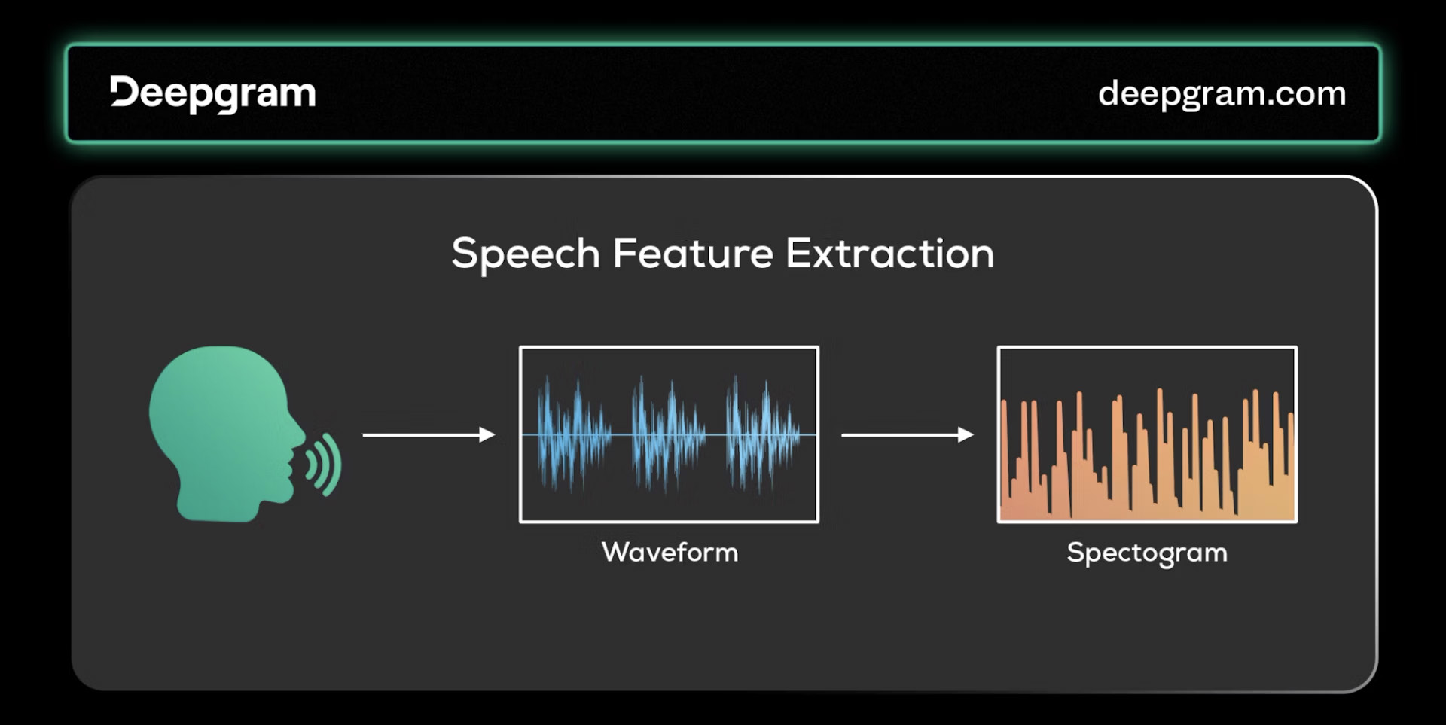
Stage 1: Speech Feature Extraction
Speech reaches the microphone as an analog wave. Nothing downstream can read it until it is digitised and reduced to features.
• Digitisation is the prerequisite for every later step.
• Fast Fourier Transform (FFT) or Mel-frequency cepstral coefficients (MFCC) extract the parts of the signal that carry meaning.
• The result is a spectrogram — frequency content over time.
• ASR models read these features, never the raw audio.
Image source: Deepgram, “Guide to Voice AI Agents” (2024)
Content adapted from: Deepgram — “Guide to Voice AI Agents” (2024)
Notes:
Analog to digital, then FFT/MFCC to a spectrogram. Stress that the model never sees a waveform in most modern systems — it sees features.

Slide 7
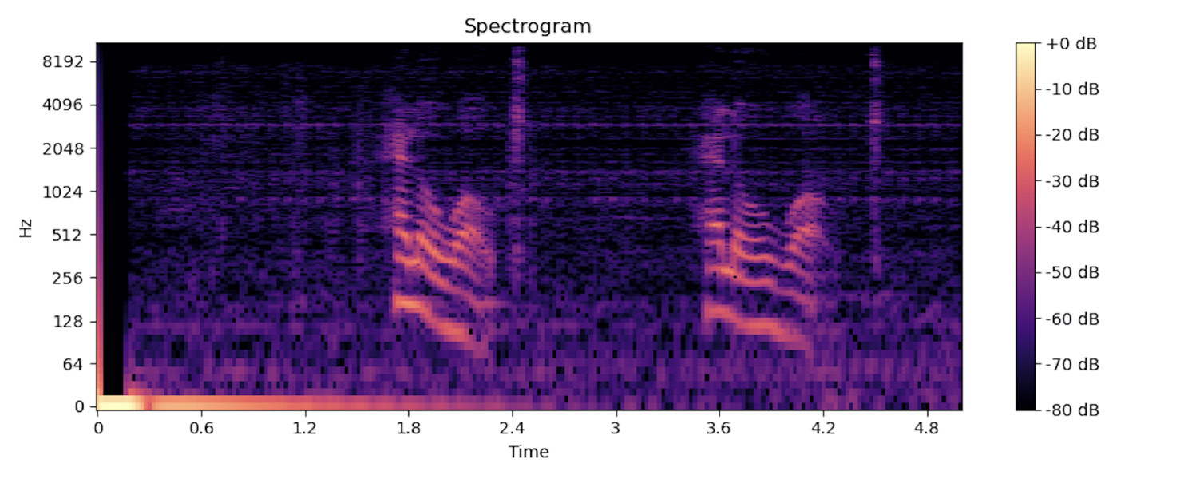
Reading a Spectrogram
Image source: Deepgram, “Guide to Voice AI Agents” (2024)
X axis — time
How the sound unfolds, left to right.
Y axis — frequency
Pitch content, low at the bottom, high at the top.
Colour — intensity
The third dimension: how loud each frequency is.
Notes:
A spectrogram is three-dimensional: time, frequency, intensity. Ask the class to spot the pauses — that is what VAD keys on.

Slide 8
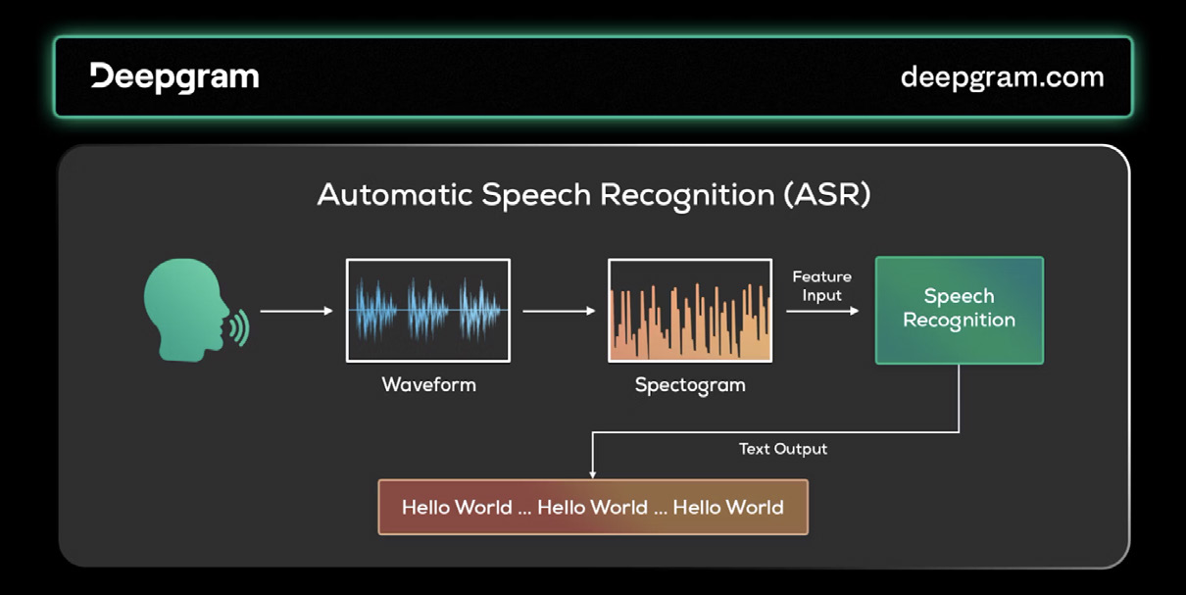
Stage 2: Inside ASR (Speech → Text)
Automatic Speech Recognition converts spoken words into written text.
• Traditional ASR: an acoustic model turns spectrogram features into phonemes — the smallest units that tell words apart.
• A language model then predicts the most likely text for that phoneme sequence.
• Modern ASR is end-to-end deep learning, mostly transformer-based (Whisper, Nova, Deepgram).
Phonemes matter: sat, cat and rat differ only in their first phoneme.
Image source: Deepgram, “Guide to Voice AI Agents” (2024)
Content adapted from: Deepgram — “Guide to Voice AI Agents” (2024)
Notes:
Acoustic model → phonemes → language model → text. Then note the shift to end-to-end transformers, which is why accuracy jumped.

Slide 9
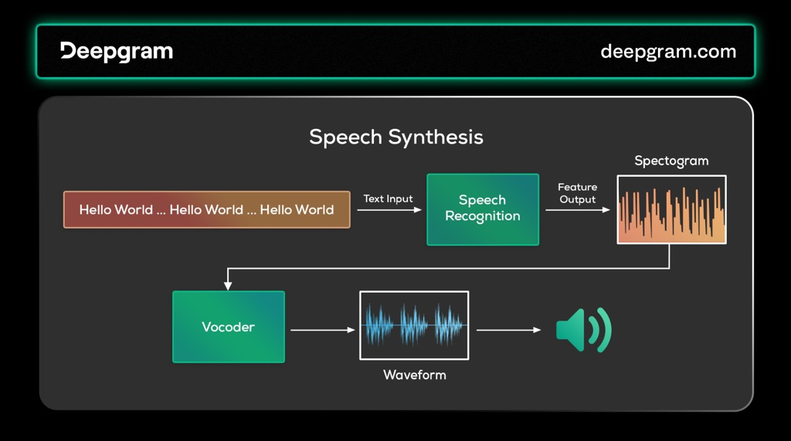
Stage 3: Inside TTS (Text → Speech)
Speech synthesis is speech recognition run backwards.
• A language model converts the text into a phoneme sequence.
• An acoustic model turns phonemes into acoustic features, handling prosody, intonation and stress.
• A vocoder synthesises the final sound waveform.
Unit selection
Stitches together pre-recorded units voiced by a real actor — phonemes, diphones or whole words.
Parametric synthesis
Generates the acoustic features directly, so any voice or style can be produced.
Image source: Deepgram, “Guide to Voice AI Agents” (2024)
Content adapted from: Deepgram — “Guide to Voice AI Agents” (2024)
Notes:
Mirror image of ASR. The vocoder is the piece students forget — it is what turns features back into sound.

Slide 10
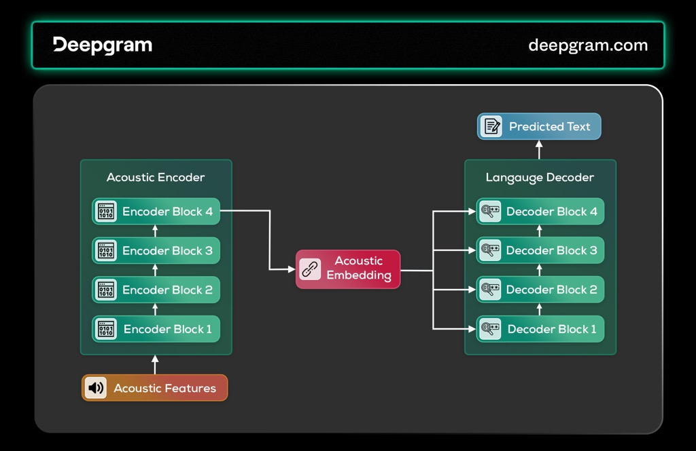
The Algorithms Behind Speech AI
Hidden Markov Models Historical
Modelled speech as transitions between hidden states (phonemes) linked to acoustic observations. Strong on sequence, weak on complex, high-dimensional data.
Convolutional Neural Networks Feature extraction
Read spectrograms like images and capture spectral and temporal patterns together — a large accuracy gain over statistical models.
Transformers Today’s standard
Self-attention processes the whole sequence at once. The encoder captures the audio, the decoder predicts text; reverse it and you get synthesis.
Transformer architecture for speech recognition. Image source: Deepgram, “Guide to Voice AI Agents” (2024)
Content adapted from: Deepgram — “Guide to Voice AI Agents” (2024)
Notes:
Three generations. Self-supervised models such as Wave2Vec learn from unlabelled audio, which is why data stopped being the bottleneck.

Slide 11
What Makes It an Agent: Perceive → Reason → Act
PERCEIVE
Gather input from the environment
Audio and text for most agents; multimodal models add images and video. A unimodal LLM only sees text.
REASON
Interpret the input and plan
Work out user intent and form a response or an action plan. Chain-of-thought handles multi-step queries.
ACT
Answer, or do the task
Speak the reply, or call a tool — search, calculator, external API, RAG — then loop back until the goal is met.
iterate until the task is done
This is the difference: a virtual assistant answers one question; an agent plans and executes multi-step work with little human oversight — booking, escalating, updating a record.
Content adapted from: Deepgram — “Guide to Voice AI Agents” (2024)
Notes:
Perceive, reason, act — and the loop. Contrast with Siri/Alexa: single turns versus multi-step workflows.

Slide 12
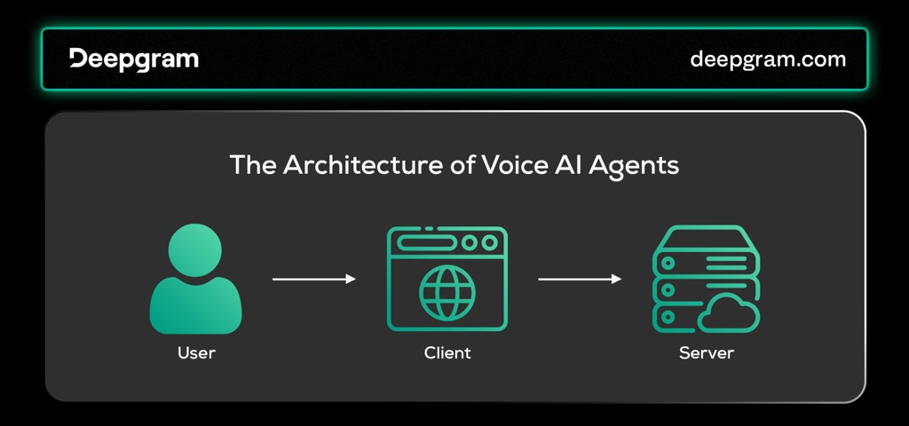
Architecture: Why Voice Agents Are Client–Server
The client captures, the server thinks.
• Clients vary: web browser, phone app, smart speaker, telephone line. Each captures speech and relays it immediately.
• The models are far too heavy to run on the device, so the work moves to the server.
• Clients still handle anything that needs a screen — forms, authentication, confirmations.
The link must be full-duplex and real time
VoIP suits phone-style deployments; WebRTC suits the browser. Client and server must speak the same protocol.
Image source: Deepgram, “Guide to Voice AI Agents” (2024)
Content adapted from: Deepgram — “Guide to Voice AI Agents” (2024)
Notes:
Ties back to the WebRTC / WebSocket slides later in the deck.

Slide 13
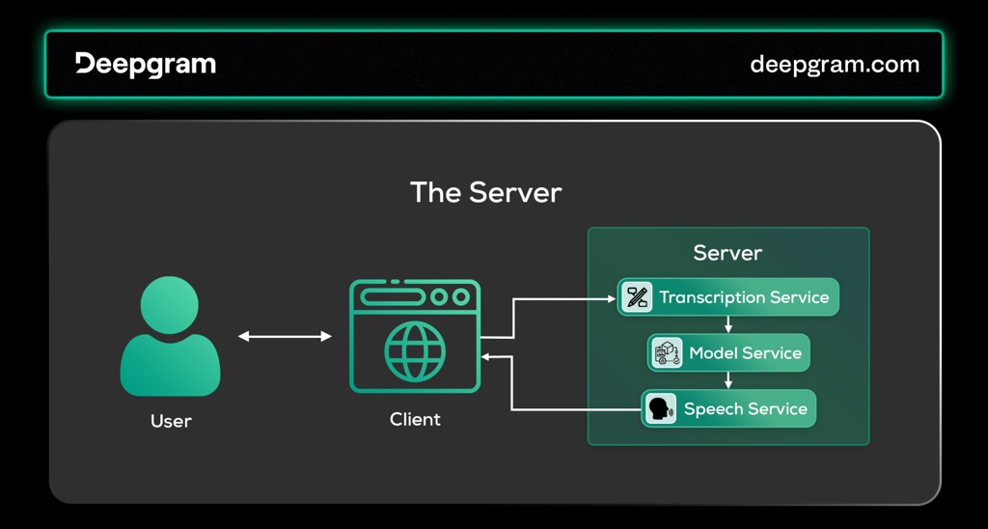
Inside the Server: Three Services
Transcription Service
ASR turns the incoming speech into text the system can act on.
Model Service
The LLM or multimodal model — the cognitive engine that understands the request, plans and decides.
Voice Service
TTS turns the textual answer back into speech for the user to hear.
Image source: Deepgram, “Guide to Voice AI Agents” (2024)
Behind them sit databases for user data and GPUs for the heavy models.
Content adapted from: Deepgram — “Guide to Voice AI Agents” (2024)
Notes:
Three services, one pipeline: speech in, meaning out, speech back. Map them onto the provider names from the earlier slides.

Slide 14
Example Providers: TTS/LLM/STT Pipeline
Output:
System Voice
Response
Or
System Video
Response
Input: User Voice
Query
Speech to
Text
LLM or Agentic LLM
workflow
Text to Speech
Example STT APIs
- Deepgram
- OpenAI
- fal
Example LLM APIs
- OpenAI, Anthropic
- Llama
- Groq
Example TTS APIs
- ElevenLabs TTS
- Cartesia TTS
- OpenAI TTS

Slide 15
Example Providers: TTS/LLM/STT Pipeline (Real Time)
Live conversation requires low latency audio streaming
Output:
System Voice
Response
Or
System Video
Response
Input: User Voice
Query
Speech to
Text
LLM or Agentic LLM
workflow
Text to Speech
Example Real-Time APIs
- Gemini Multimodal Live
- OpenAI Realtime
- Azure OpenAI Realtime

Slide 16
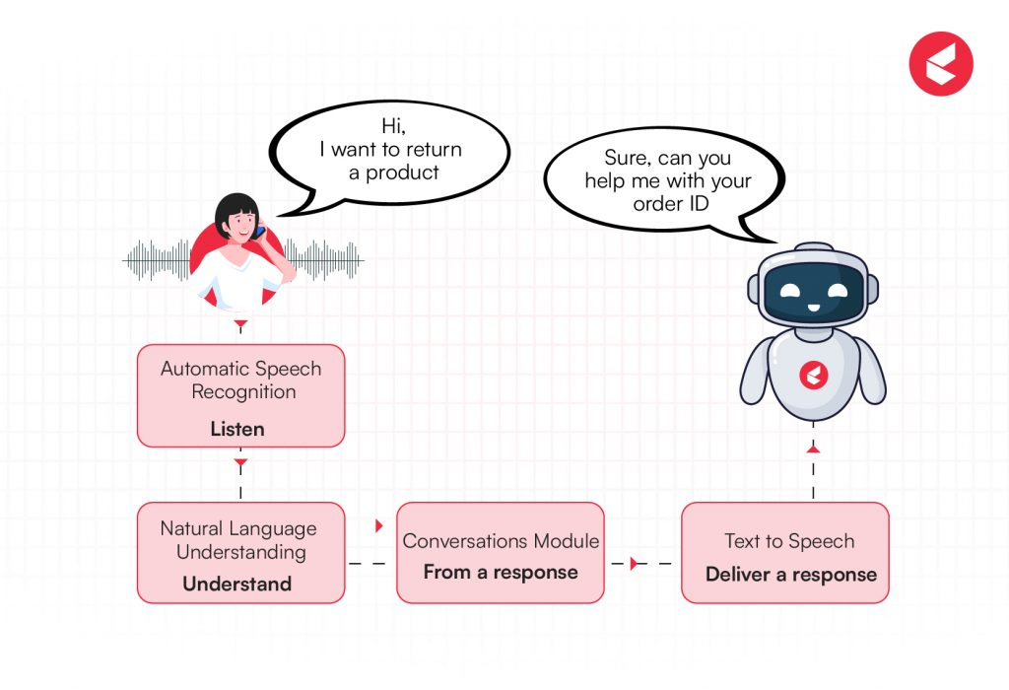
AI Voice Agent — Call Management
Call management refers to how an AI voice agent handles the flow of a live call — from detecting when a person starts or stops speaking, managing turn-taking, handling interruptions, to controlling session state (hold, transfer, end).
A good call management system ensures natural, human-like interaction, even though multiple processes (ASR, NLP, TTS) are running behind the scenes in real time.
Image source: https://www.kapture.cx/blog/ai-voice-bot/

Slide 17
Core Components of Call Management
Component | Description | Purpose
VAD (Voice Activity Detection) | Detects speech vs silence from audio stream. | Helps system decide when to start/stop STT processing.
Endpoint Detection | Determines when user has finished speaking. | Prevents premature cutoff or long silences.
Barge-In Detection | Detects user interruption while TTS is playing. | Enables natural interruptions (user can stop the bot mid-sentence).
Turn-Taking Management | Coordinates who speaks when (bot vs user). | Avoids overlaps, ensures fluid dialogue.
Call State Management | Tracks call lifecycle — start, hold, resume, transfer, end. | Integrates with telephony or CRM backend.
Session Context Tracking | Maintains conversational state and user intent. | Ensures continuity within the same call.

Slide 18
Call Flow Architecture
One turn of a live call, left to right
User voice input
audio stream opens
VAD
detect speech start / stop
Streaming ASR
partial transcription
LLM / NLU
intent recognition
NLG
response generation
TTS
speech output
Barge-in: if the user speaks while the agent is talking, VAD fires again, TTS is stopped and the loop restarts from the new input.
Everything is streamed. ASR emits partial hypotheses while the user is still speaking, the LLM starts generating before the sentence ends, and TTS begins speaking before the answer is complete — that is how a sub-second response is possible at all.
Notes:
Walk one turn left to right, then the barge-in loop. Emphasise streaming at every stage.

Slide 19
Voice Activity Detection (VAD)
Definition: VAD determines when speech is present in an audio stream.
Benefits:
• Reduces computation by processing only speech
• Avoids empty or noisy segments being sent to STT
• Enables accurate end-of-speech detection
Key techniques:
• Energy-based detection (simple threshold)
• Spectral-based (FFT, frequency domain)
• Deep learning-based (Silero VAD, WebRTC VAD)
• Example Workflow:
• Audio Stream → VAD model → Speech segments (start_time, end_time)

Slide 20
Barge-In & Turn-Taking Control
Barge-In:
• Allows the user to interrupt the bot mid-sentence.
• Critical for human-like interaction.
• Requires continuous monitoring of input audio during TTS output.
Implementation example:
• TTS playback thread runs asynchronously.
• VAD/ASR continues listening on the input channel.
• If user speech detected → stop TTS → send new utterance to NLP.

Slide 21
Turn-Taking Management
Turn-taking ensures smooth dialogue flow between user and agent.
Strategy | Technique
Timer-based | Wait for silence > X ms to decide end of user speech.
Semantic-based | Predict intent completion (“yes”, “okay”, “that’s all”).
Hybrid approach | Combine VAD + semantic signal for natural pauses.

Slide 22
Call Session & State Management
Voice agents often integrate with telephony systems (SIP, Twilio, Vonage, Asterisk, etc.).
Session management tasks:
• Call Start: Answer incoming call, initiate session ID.
• Authentication: Identify user or retrieve context.
• Active Call: Handle multiple conversation turns.
• Hold / Transfer: Pass control to human agent or another service.
• End Call: Confirm closure, save call log, metrics.
• Backend systems: Use a Session Manager service or Redis/Mongo to track real-time call states and history.

Slide 23
Challenges in Implementing AI Voice Bots
1. Real-Time Latency
• Users expect sub-second responses; delays break natural conversation flow.
• Caused by sequential STT → LLM → TTS processing and network lag.
2. Speech Recognition Accuracy
• Background noise, accents, code-switching, and poor microphones degrade ASR performance.
• Domain-specific vocabulary often misrecognized.
3. Voice Activity & Turn-Taking
• Detecting when users start/stop speaking is difficult.
• Requires robust VAD, interruption (barge-in) handling, and echo cancellation.

Slide 24
Challenges in Implementing AI Voice Bots
4. Naturalness of Speech Output
• TTS voices can sound robotic or emotionally flat.
• Prosody and tone adaptation to user context are still limited.
5. Integration & Context Management
• Need to connect with CRM, telephony, and databases in real time.
• Maintaining context across multi-turn calls is complex.
6. Privacy & Compliance
• Handling voice data securely (GDPR, PDPA).
• Avoiding storage of sensitive personal or biometric information.

Slide 25
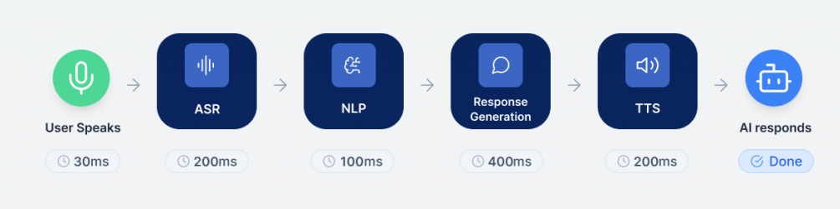
Understanding Voice-to-Voice Latency
Latency is perhaps the most critical factor in voice agent performance. In human conversation, responses typically arrive within 500ms, and responses beyond 1000ms feel unnaturally delayed. For voice AI agents to feel natural, they must achieve similar responsiveness. This guide explores optimization strategies across all layers of the voice AI stack.
Image source: https://www.voicespin.com/

Slide 26
Latency Lower Bounds
Latency of Human Interactions
Humans expect a response on avg within 230ms (std dev = 520ms) from the end of their interlocutor’s turn
Note: estimates for English, other languages may be up or down
Latency of Voice Agent interactions (Note: all streaming APIs for STT/LLM/TTS)
Task | Latency
VAD(LiveKit’s) | 20ms
EOU(LiveKit’s) | 100ms
ASR/STT | 100-500ms
LLM (time to first token) | 200-550ms
TTS (time to first byte) | 100-450ms
Interlocutor: a person who takes part in a dialogue or conversation.

Slide 27
Speech-to-Text (STT) Optimization
Streaming Transcription
Rather than buffering the entire user utterance, streaming speech-to-text transcribes audio on the fly. As the user speaks, partial text hypotheses are produced every few hundred milliseconds. This allows the system to get a head start on understanding the query.
By the time the user finishes speaking (or even before they finish), the agent may already have most of the text. For example, with a capable streaming ASR, an utterance might be recognized with only ~200 ms delay from speech.

Slide 28
Speech-to-Text (STT) Optimization
Edge Deployment for STT
Edge deployment or on-device STT can eliminate network latency entirely. For example, running Whisper locally in a browser can add as little as ~300 ms overhead for transcription. When using cloud STT, placing the service in a region close to users or co-located with your other components can avoid extra network hops.
Scenario: Consider a call center deploying voice AI to handle customer queries. By running a lightweight STT model (like Deepgram’s Nova-3) in the same data center as the telephony system, you reduce transcription latency by 50-100ms compared to sending audio across regions.

Slide 29
LLM Optimization Strategies
Model Selection for Real-Time Voice
For real-time dialogue, not all LLMs are created equal. Time-to-First-Token (TTFT) is crucial.
Sub-500ms TTFT is the goal to make the AI seem to respond immediately as you finish speaking. In practice, the average latency per query (from end of user speech to start of agent speech) has been measured around 300–700 ms with optimized stacks using these models.

Slide 30
LLM Optimization Strategies
Warm-Up and Startup Optimization
• If using an API-based LLM (like OpenAI), the very first request in a session may incur extra latency (due to loading the model or caching the prompt). One trick is to send a lightweight “warm-up” query in advance.
• Scenario: When a user calls into a customer service voice agent, send a simple “ping” request to the LLM during the initial greeting (“Thank you for calling…”). By the time the user states their question, the model is already warm and can respond quickly.
Some developers issue a dummy prompt (e.g. “ping”) to the LLM when a call begins or even periodically during idle times, just to keep the model instance warm. This can reduce latency for the real user queries that follow, since the model’s context cache is already initialized on the server.

Slide 31
LLM Optimization Strategies
Semantic Caching
Semantic caching stores previous queries and LLM answers so that semantically similar prompts can reuse results without a full model call. Unlike traditional key-value caching (which hits only on exact string matches), semantic caching uses embeddings to match queries by intent, not exact wording.
How it works:
• Convert incoming prompt into a vector embedding.
• Perform a similarity search in a vector database.
• If a similar query is found above threshold, return cached answer.
• Otherwise, generate new response and add to cache.
• Hitting the cache is far faster than a full LLM run. A self-hosted semantic cache can answer in ~50 ms (or ~200 ms via an API call) versus an LLM which might take seconds.

Slide 32
LLM Optimization Strategies
Context Management
Feeding long conversation histories or verbose prompts into an LLM is a major source of latency. The more tokens the model must process, the longer it takes to produce a response.
Strategies for prompt optimization:
• Rolling Context Windows: A simple heuristic is to include only the last N turns of dialogue verbatim, and omit or summarize older turns. This creates a sliding window that “forgets” distant history except for a synopsis.
• Prompt Summarization: Rather than resending the entire chat history each turn, distill older turns into a concise summary. For example, after a few exchanges, a voice agent can replace the detailed transcript of earlier dialogue with a one-sentence summary or extracted facts.

Slide 33
Text-to-Speech (TTS) Optimization
Word-Level Timestamps and Interruption Handling
For conversational voice use cases, being able to track what text the user heard is important for maintaining accurate conversation context. This requires that a model generate word-level timestamp metadata in addition to the audio, and that the timestamp data be reconstructible backwards to the original input text.
This capability is crucial for handling user interruptions: The instant the user starts speaking while the agent is talking, the agent should stop its speech. This is table stakes for natural dialogue – we’ve all experienced voice systems that annoyingly keep talking even when we’re trying to interject; that’s what to avoid.

Slide 34
Text-to-Speech (TTS) Optimization
Streaming TTS
Streaming text-to-speech is the counterpart to streaming STT. Instead of waiting for the full generated sentence, advanced TTS systems can start synthesizing audio from the first chunk of text and continue as more text comes in. This means as soon as the LLM produces a few words, the agent’s voice can start speaking them.

Slide 35
Approach: Real Time Peer-to-Peer Communication
Web Real-Time Communication (WebRTC) is a free open source project providing web browser and mobile applications with real-time communication via APIs.
WebSocket network communication protocol to establish a client-server ‘handshake’.
Core elements: asynchronous processing and careful management of I/O stream & streaming APIs (i.e. STT/TTS/LLM)
Your Client
Front End
Back End
Web
LiveKit Cloud
(or OSS Server)
STT
Mobile
HTTP/WebSocket
LLM
WebRTC
WebRTC
agent
Phone
TTS
Multimodal Model

Slide 36
Connection between Computers
To optimize the voice call, it depends on the connection between computers.
TCP vs UDP.
Feature | TCP | UDP
Connection | Connection-oriented (requires a handshake before data transfer). | Connectionless (no handshake, just sends).
Reliability | Reliable (guarantees delivery, retransmits lost packets, checks order). | Unreliable (no guarantee of delivery or order).
Speed | Slower (because of error checking, acknowledgments, retransmissions). | Faster (minimal overhead, no retransmission).
Data Order | Maintains order of packets. | No ordering – packets may arrive out of order.
Error Checking | Yes (with error correction). | Yes (with checksum), but no correction.
Overhead | Higher (because of headers: 20–60 bytes). | Lower (header: 8 bytes).
Use Cases | Web browsing (HTTP/HTTPS), email (SMTP/IMAP), file transfers (FTP), remote login (SSH). | Live streaming, online gaming, VoIP, DNS queries.

Slide 37
Web Protocols — WebSocket vs WebRTC
Higher level protocol on browser
Browser
Hypertext Transfer Protocol (HTTP)
WebSocket
(WS)
Web Real-time Communication
(WebRTC)
Transmission Control Protocol
(TCP)
User Datagram Protocol
(UDP)
Internet Protocol (IP)

Slide 38
Importance in Voice Agent
Why real-time protocols matter
Enables real-time interaction: Both are essential for a voice agent to engage in a dynamic, back-and-forth conversation rather than a rigid, one-question-at-a-time exchange.
Improves user experience: Effective turn detection, particularly context-aware models, avoids abrupt interruptions and awkward silences, leading to more natural and efficient communication.
Cost reduction: Accurate VAD can prevent processing and sending large amounts of voiceless audio to expensive speech-to-text pipelines.

Slide 39
Measuring a Voice Agent: Objective Metrics
Word Error Rate (WER)
How closely the transcript matches what was actually said — the core accuracy measure for ASR.
Real-Time Factor (RTF)
Processing time ÷ audio duration. RTF below 1.0 means the system keeps up with live speech — essential for conversation.
WER = (Substitutions + Insertions + Deletions) ÷ Total words
Mel-Cepstral Distortion (MCD)
Compares the spectral properties of synthesised speech against real speech — an objective stand-in for “does it sound right?”.
Variants: Sentence Error Rate (SER) and Character Error Rate (CER).
Measure the stack, not just the model: WER for the ears, RTF for the clock, MCD for the voice — plus the voice-to-voice latency budget from earlier in this lecture.
Content adapted from: Deepgram — “Guide to Voice AI Agents” (2024)
Notes:
Work an example: 10 words, 1 substitution and 1 deletion gives WER 0.2. Remind them WER alone says nothing about whether the agent was useful.

Slide 40
Subjective Metrics and Benchmarks
Naturalness
Listener ratings of how human and how intelligible the output sounds. Standardised listening tests with diverse participants reduce bias.
Mean Opinion Score
Listeners rate a TTS sample from 1 (poor) to 5 (excellent); the average is the MOS.
Human evaluation
Task completion rate and feedback quality — the closest thing to “was the agent actually useful?”
MOS scale
1
2
3
4
5
Benchmarks used to compare systems
GLUE
General language understanding of the LLM behind the agent
ASR-GLUE
Speech tasks: translation, emotion recognition and more
AgentBench
Eight environments testing reasoning and decision-making
OmniACT
Agent performance on digital, on-screen tasks
LJSpeech
24 hours of single-speaker audio for evaluating TTS
Content adapted from: Deepgram — “Guide to Voice AI Agents” (2024)
Notes:
Objective numbers do not capture whether people liked talking to it. MOS and task completion do.

Slide 41
Data Handling and Privacy
Data collection
Voice, biometrics, preferences, location and interaction history. Say what you collect and get explicit consent.
Data processing
Audio to text, noise filtering, intent detection. Anonymise where you can without breaking the service.
Data storage
Decide what is kept — raw audio or text — and enforce a lifecycle policy so nothing outlives its purpose.
Privacy concerns
Publish how data is used, control access, and let users see, correct or delete their data.
Security measures
Encryption and authentication, plus network and application security and regular penetration testing.
Regulatory compliance
GDPR, CCPA and the Privacy Act. Design for privacy from the start rather than retro-fitting it.
Voice is biometric data. A recording identifies the speaker, so consent, retention limits and encryption are not optional extras — they are part of the design.
Content adapted from: Deepgram — “Guide to Voice AI Agents” (2024)
Notes:
Six stages. The one students underestimate is storage — keeping raw audio 'just in case' is where most privacy incidents start.

Slide 42
AI Voice Agent Use Cases
Type | Purpose | Example Capabilities
Virtual Assistants | General-purpose agents handling diverse tasks across domains | Siri, Alexa, enterprise personal assistants
Customer Service Agents | Provide product support, troubleshooting, and escalation | Handle FAQs, detect frustration, transfer to human agent
Appointment Schedulers | Manage calendars and bookings efficiently | Schedule meetings, confirm appointments, send reminders
Information Retrievers | Deliver targeted information from internal or public data | Access knowledge bases, databases, or documents
Transactional Agents | Execute business transactions and workflows | Process payments, bookings, or orders with backend integration
Industry-Specialized Agents | Designed for specific sectors and terminology | Healthcare scheduling, financial advisory, logistics coordination

Slide 43
References
https://www.voicespin.com/glossary/voice-activity-detection/
https://www.youtube.com/watch?v=xWhI8RkRSGQ&t=60s
Deepgram (2024). Guide to Voice AI Agents. https://deepgram.com/
LiveKit. Building voice agents. https://docs.livekit.io/agents/
Silero VAD (voice activity detection). https://github.com/snakers4/silero-vad
WebRTC — real-time communication for the web. https://webrtc.org/

